Slide 1
Database Scaling: Replication and Sharding

Slide 2
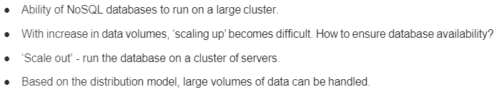

Managing database for availability and performance

Slide 3
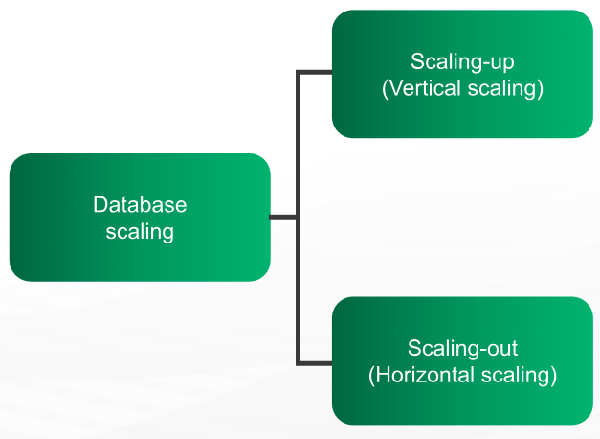
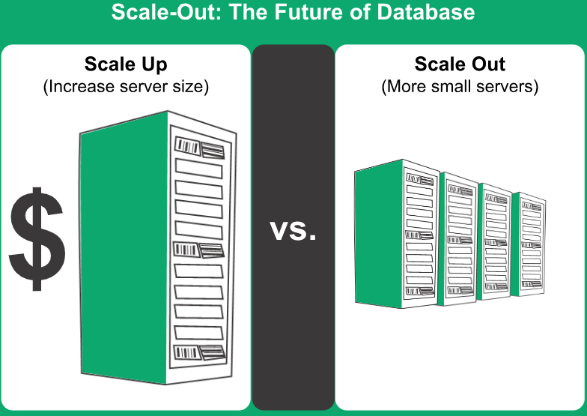
Database Scaling
Scaling-up/Vertical scaling: means upgrading a server, by means of adding more memory, faster processor, or larger storage devices. Adding more hardware can help increase the amount of traffic a server can support and the amount of data it can process in a reasonable period of time.
Scaling-out/Horizontal scaling: means adding more servers to the task. Though, this is complex process, this helps in increasing the capacity to a great extent. In one way, the additional servers act as backup devices and play their role when the main server fails. In other ways, work and network traffic can be shared between all the servers. When many servers are added to the task, the group of machines assigned to a particular task is called as cluster.

Slide 4
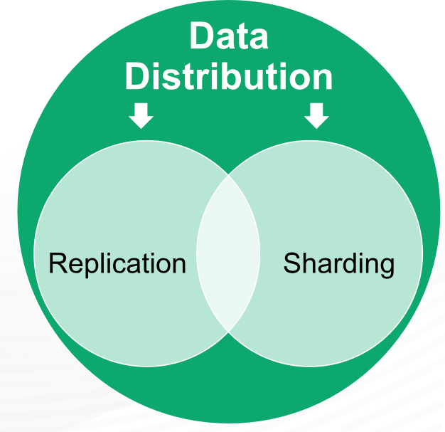
Database Distribution Models
Replication: Same data is copied on multiple servers.
Sharding: Data is put on multiple nodes.

Slide 5
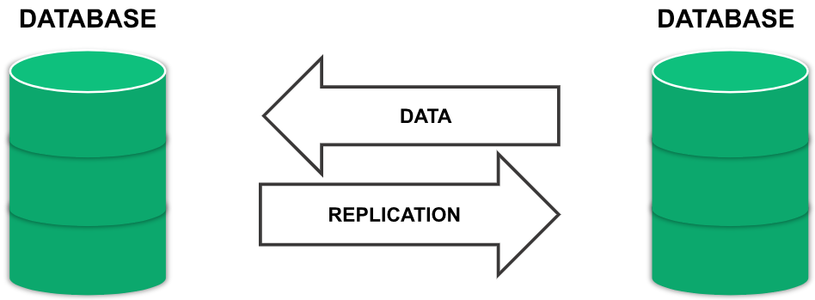
Data Replication
Process of keeping the data synced.
Complete copy of database on a different server.
When the primary server fails, the backup server will come online and take the responsibility.
Reduced downtime compared to fixing failures manually
System automatically detects failures and activate backup machines.

Slide 6
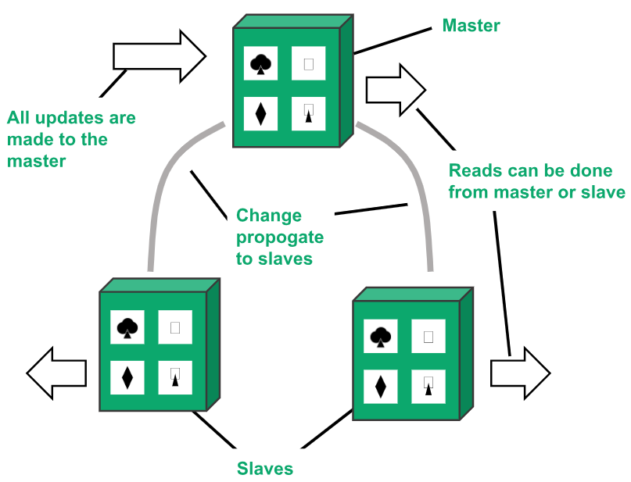
Types of database replication
1. Master-slave replication (Passive Replication):
One master or primary node and others are slaves.
Master is the primary source of data and designed to process updates and send to slaves.
Slaves are used for read operation.
Used for read-intensive datasets.
Horizontal scaling possible by adding more slaves.
Masters can be appointed manually and automatically.

Slide 7
Master Slave Replication
Master-Slave Replication can be synchronous or asynchronous. The difference is simply the timing of propagation of changes.
If the changes are made to the master and slave at the same time, it is synchronous.
If the changes are queued up and written later, it is asynchronous.

Slide 8
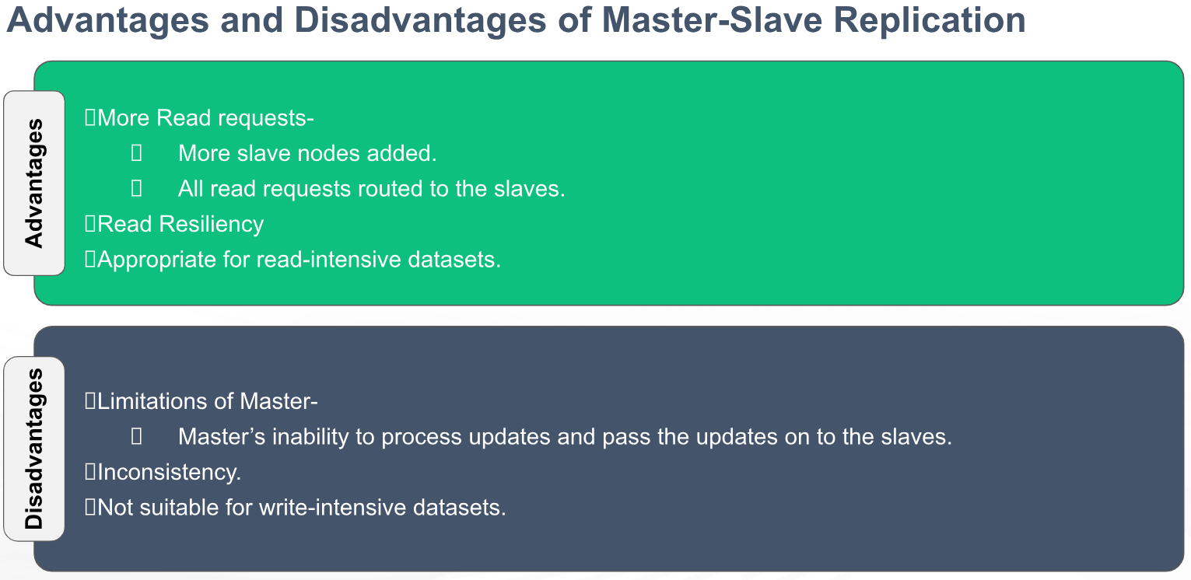
Notes:
Data resiliency is the ability of a system to protect data and keep it available even in case of failures, errors, or disasters.

Slide 9
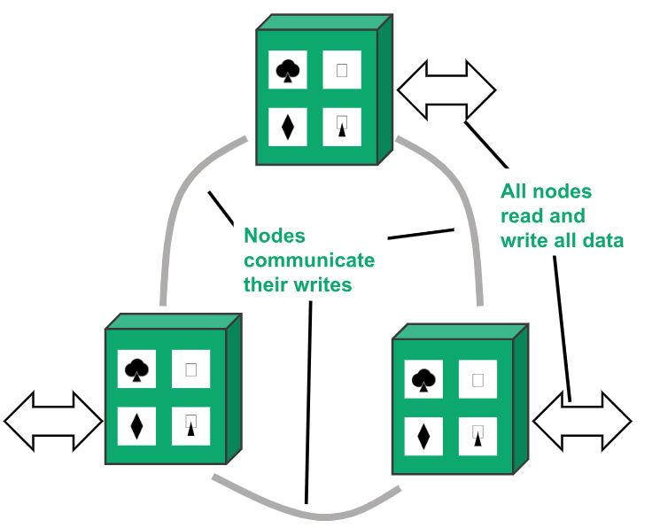
2. Peer-to-Peer Replication (Active Replication):
Very useful for improving the ‘write’ scalability that is not offered by master-slave replication.
There is no master and no single point of failure.
All the replicas are equal and accept the writes and reads.
More nodes can be added for performance improvement.

Slide 10
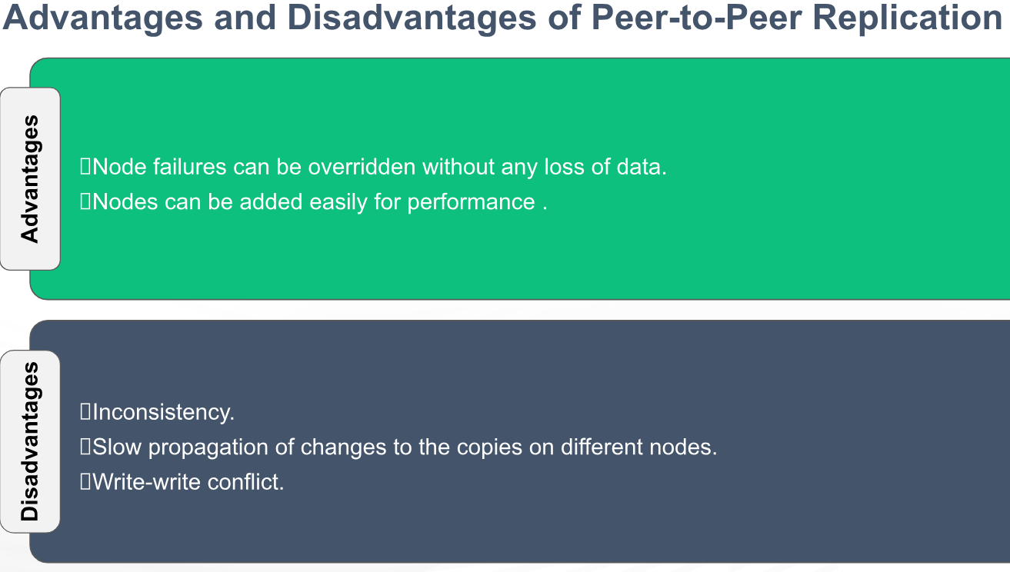

Slide 11
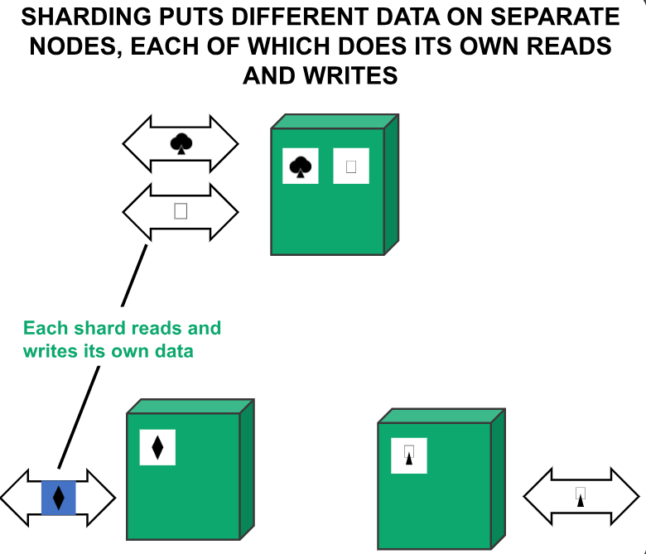
Introduction to Sharding
Sharding is a method for distributing data across multiple machines.
Defined as “shared-nothing” partitioning schema for large databases across a number of servers.
Method of splitting and storing a single logical dataset in multiple databases.
MongoDB uses sharding to support deployments with very large data sets and high throughput operations.
Optimization technique to achieve horizontal scaling in DB.
Database systems with large data sets or high throughput applications can challenge the capacity of a single server.

Slide 12
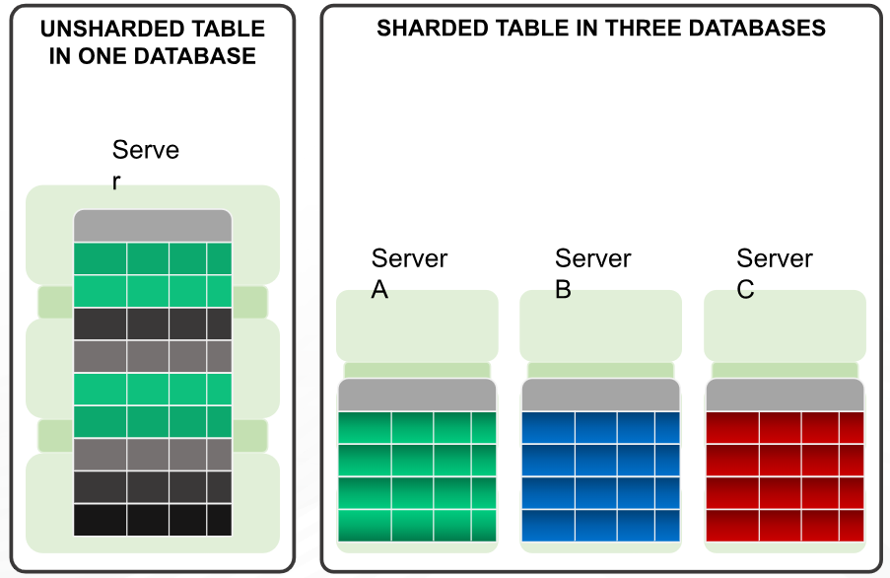
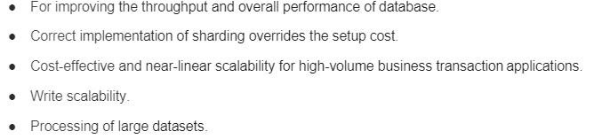
Why Sharding?

Slide 13
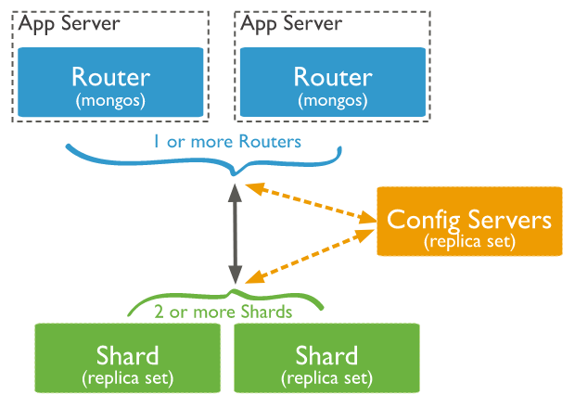
Sharding components
Shard: A shard is a single MongoDB instance that holds a subset of the sharded data. Shards can be deployed as replica sets to increase availability and provide redundancy. The combination of multiple shards creates a complete data set. For example, a 2 TB data set can be broken down into four shards, each containing 500 GB of data from the original data set.
Mongos: Mongos act as the query router providing a stable interface between the application and the sharded cluster. This MongoDB instance is responsible for routing the client requests to the correct shard. Consumes minimal system resources so can be used on existing application servers.
Config Servers: Configuration servers store the metadata and the configuration settings for the whole cluster.

Slide 14
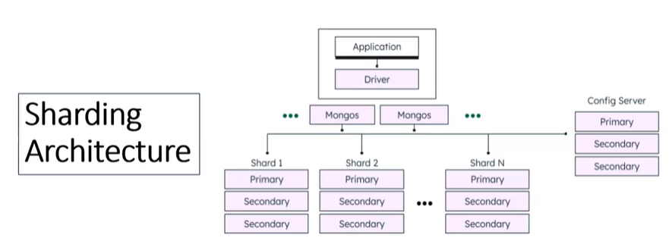
How Sharding Works?
The application communicates with the routers (mongos) about the query to be executed.
The mongos instance consults the config servers to check which shard contains the required data set to send the query to that shard.
Finally, the result of the query will be returned to the application.

Slide 15
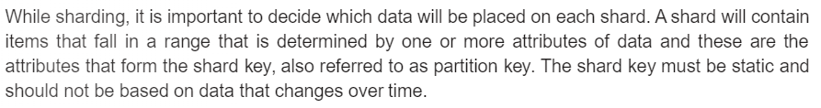
How Sharding works?
How will the data be distributed across shards? A data store is divided into horizontal partitions or shards. A shard is a data store in its own way, running on a server, acting as a storage node.
Shard or partition Key: MongoDB uses the shard key to distribute the collection's documents across shards.
The shard key consists of a field or multiple fields in the documents.
The shard key is either a single indexed field or multiple fields covered by a compound index that determines the distribution of the collection's documents among the cluster's shards.
Logical Shard: is how data is divided based on the shard key. (plan/logic).
Physical Shard: also referred to, a database node, is the actual server or machine where data is stored.

Slide 16
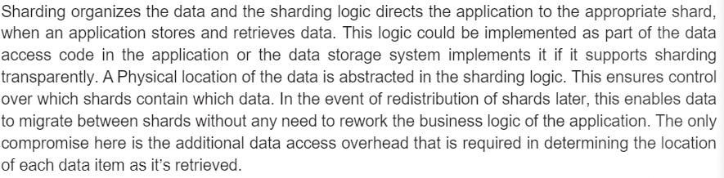
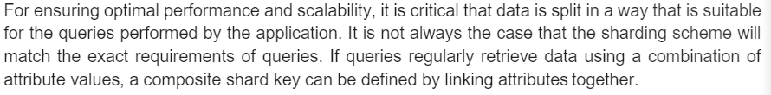
Steps to shard a collection using a shard key:
use myDatabase
sh.enableSharding("myDatabase")
db.myCollection.createIndex({ userId: 1 }) //Shard key must be indexed
sh.shardCollection("myDatabase.myCollection", { userId: 1 })
{ userId: 1 } → shard key
1 = ascending index

Slide 17
Shard key
When sharding a MongoDB collection, a shard key gets created as one of the initial steps.
The “shard key” is used to distribute the MongoDB collection’s documents across all the shards.
The key consists of a single field or multiple fields in every document.
The sharded key is immutable and cannot be changed after sharding because data is already distributed across shards using the original key and changing it would require re-sharding the entire dataset.
A sharded collection only contains a single shard key.
For example,
sh.shardCollection("ecommerce.orders", { userId: 1 })
Now, every document in orders is placed based on userId . MongoDB will always use this same key
You cannot later say: “Use productId for some documents” and “Use date for others”

Slide 18
Shard key
The shard key can directly have an impact on the performance of the cluster. Hence can lead to bottlenecks in applications associated with the cluster.
To mitigate this, before sharding the collection, the shard key must be created based on:
The schema of the data set
How the data set is queried

Slide 19
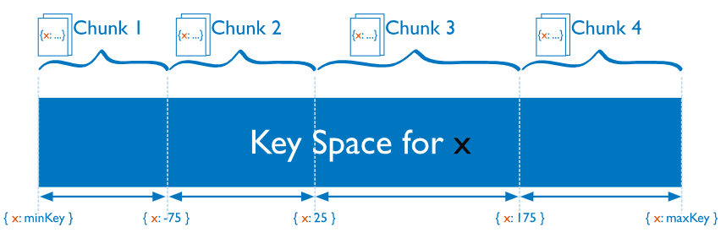
Chunks: Chunks are subsets of shared data. MongoDB separates sharded data into chunks that are distributed across the shards in the shared cluster. Each chunk has an inclusive lower and exclusive upper range based on the shard key. A balancer specific for each cluster handles the chunk distribution.
The balancer runs as a background job and distributes the chunks as needed to achieve an even balance of chunks across all shards. This process is called even chuck distribution.
sh.splitAt("myDatabase.myCollection", { userId: 100 }) sh.splitAt("myDatabase.myCollection", { userId: 200 })
sh.moveChunk("myDatabase.myCollection", { userId: 150 }, "shard0001")
sh.shardCollection("myDatabase.myCollection", { userId: "hashed" })

Slide 20
Choose a Shard Key
The choice of shard key affects the creation and distribution of chunks across the available shards. The distribution of data affects the efficiency and performance of operations within the sharded cluster.
The ideal shard key allows MongoDB to distribute documents evenly throughout the cluster while also facilitating common query patterns.
When you choose your shard key, consider:
The cardinality of the shard key: The cardinality of a shard key determines the maximum number of chunks the balancer can create. Where possible, choose a shard key with high cardinality. A shard key with low cardinality reduces the effectiveness of horizontal scaling in the cluster. A unique shard key value can exist on a single chunk.
The frequency with which shard key values occur: The frequency of the shard key represents how often a given shard key value occurs in the data. If the majority of documents contain only a subset of the possible shard key values, then the chunks storing the documents with those values can become a bottleneck within the cluster.
Sharding Query Patterns: consider your most common query patterns and whether a given shard key covers them.
You should not choose a key which frequently changes.

Slide 21
Cardinality of the shard key
Cardinality refers to the number of unique values in a potential shard key i.e. the number of distinct values for a field used to distribute data across shards.
It is a critical factor in determining how effectively a database can scale horizontally.
High Cardinality: A shard key with many unique values (e.g., user_id, email) allows for fine-grained data distribution and supports a large number of shards.
Low Cardinality: A key with very few unique values (e.g., is_premium boolean or continent with only 7 values) limits the total number of shards you can effectively have. For instance, a boolean key limits you to just two shards.
Select High-Cardinality Keys: Choose unique identifiers like user_id or order_id to ensure data can be split into many small, manageable pieces.
Compound Shard Keys: If your primary field has low cardinality, combine it with another field (creating a "compound shard key") to increase total uniqueness.
Avoid Monotonic Keys: Even with high cardinality, avoid keys like timestamps that increase sequentially, as all new writes will hit the same shard, creating a bottleneck.

Slide 22
Frequency of the shard key
Frequency refers to how often a specific shard key value occurs within the dataset.
High frequency of a particular key means that a large portion of data shares that same key value, which can lead to data imbalance and performance bottlenecks.
Data Distribution: Frequency measures the distribution of data across possible values. A good shard key should have low frequency—meaning no single value dominates the dataset—to ensure that no single shard becomes overwhelmed.
Database Hotspots: If a shard key has high frequency (e.g., sharding a global application by "Country" where 90% of users are in one country), the shard holding that high-frequency key becomes a "hotspot". This shard will handle most of the reads/writes, causing performance degradation.
Impact on Scalability: High-frequency keys, even if they have high cardinality (many unique values), can result in unevenly sized shards. For instance, in a fitness app, a shard for "ages 30–45" might have much higher frequency (more data) than "ages 80+".
Frequency vs. Cardinality
Cardinality: The number of unique values a shard key has (e.g., user_id has high cardinality; gender has low cardinality).
Frequency: How often each of those unique values appears in the dataset
Ideal Scenario: High Cardinality + Low Frequency.

Slide 23
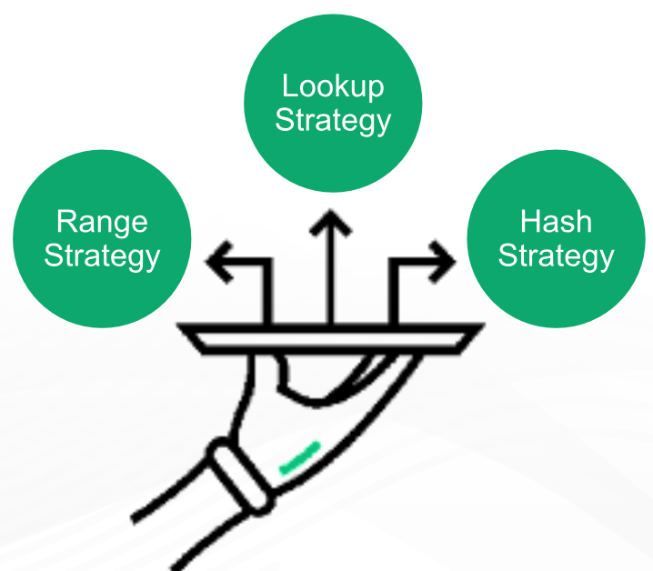
Sharding strategies
There are three major strategies commonly used when selecting the shard key and distributing the data across shards.

Slide 24
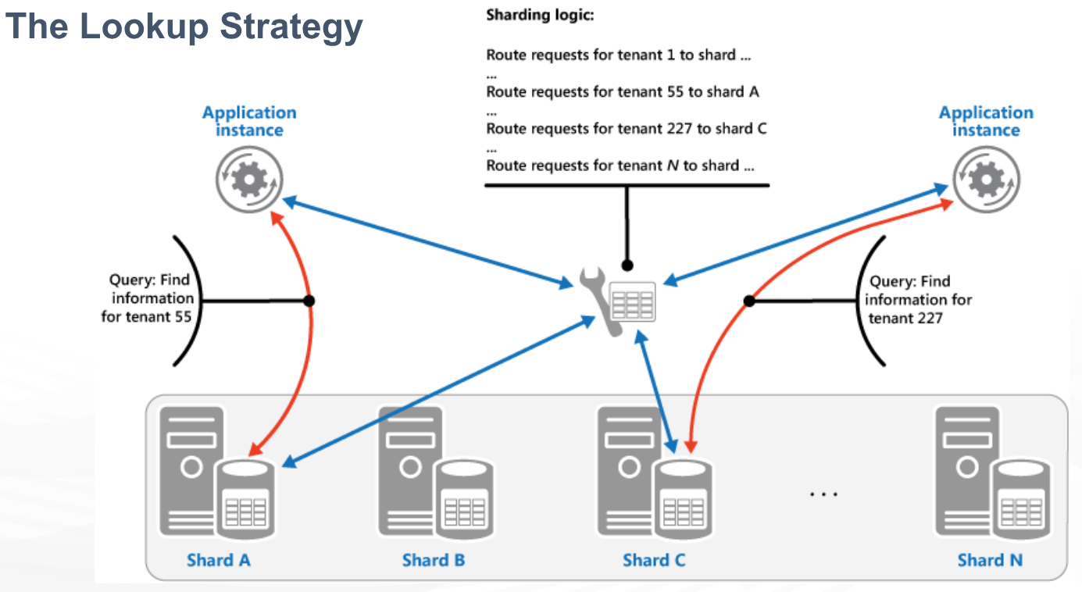
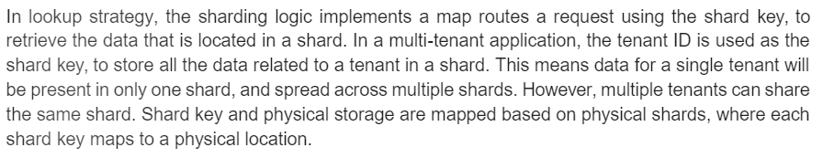

Slide 25
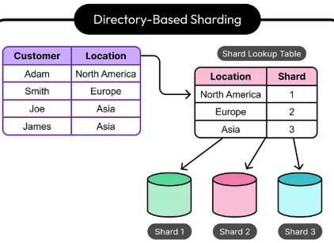
Look-up Stratergy
Lookup-based sharding (or directory-based sharding) uses a centralized lookup table or service to map specific data keys (like user IDs) directly to a specific physical shard.
This strategy offers maximum flexibility, allowing for custom data placement and easy rebalancing by updating the map, but it requires an extra lookup step for every request.
Maintains a mapping (lookup table) where Key -> Shard ID.
Advantages: Highly flexible; allows for custom distribution (e.g., placing all European customers on one shard) and easy rebalancing.
Disadvantages: Introduces a single point of failure and bottleneck (the lookup table). Increased latency for queries due to the lookup step.
Use Cases: Ideal for scenarios requiring flexible,
non-algorithmic data placement, such as mapping
users to specific geographic shards (geosharding).

Slide 26
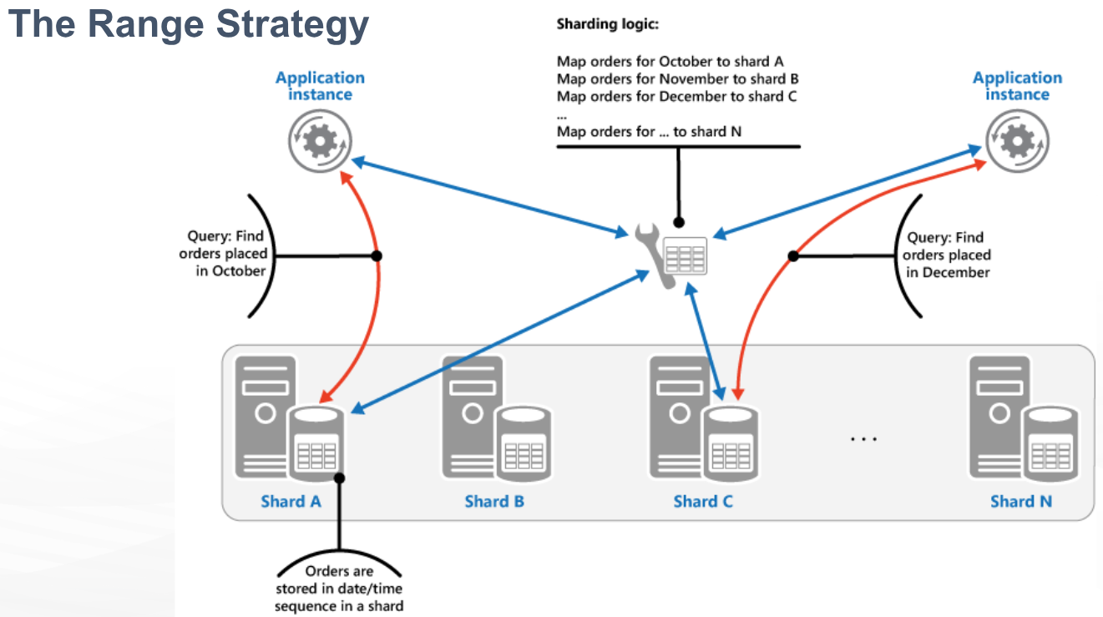

Slide 27
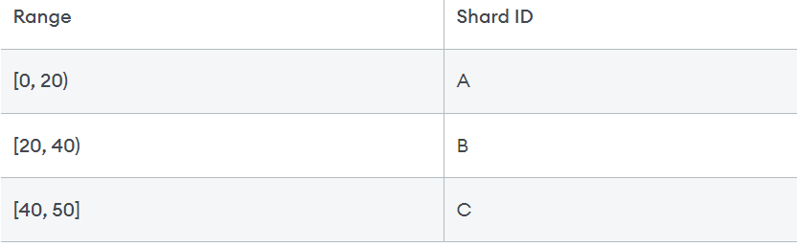
Ranged sharding, or dynamic sharding, takes a field on the record as an input and, based on a predefined range, allocates that record to the appropriate shard. Ranged sharding requires there to be a lookup table or service available for all queries or writes. For example, consider a set of data with IDs that range from 0-50. A simple lookup table might look like the following:
The field on which the range is based is also known as the shard key. Naturally, the choice of shard key, as well as the ranges, are critical in making range-based sharding effective. A poor choice of shard key will lead to unbalanced shards, which leads to decreased performance. An effective shard key will allow for queries to be targeted to a minimum number of shards. In our example above, if we query for all records with IDs 10-30, then only shards A and B will need to be queried.

Slide 28
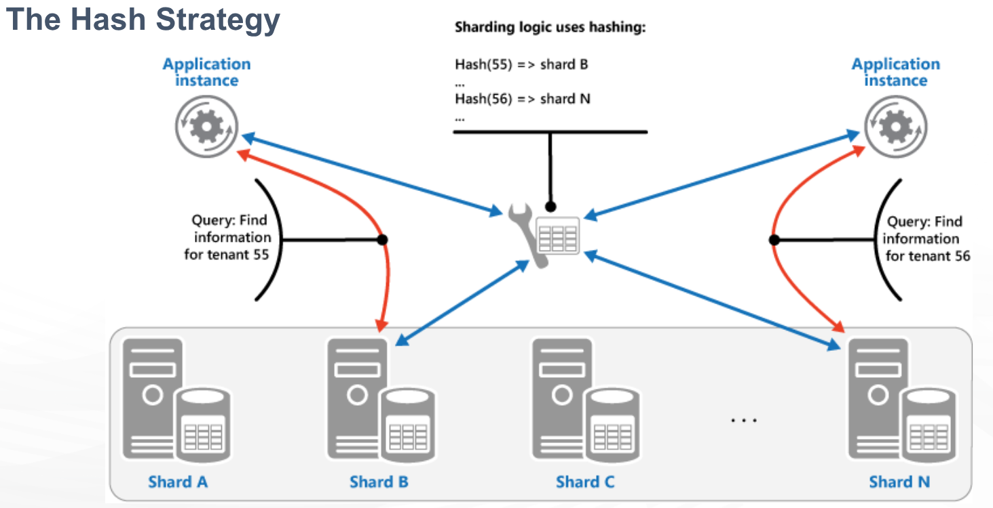
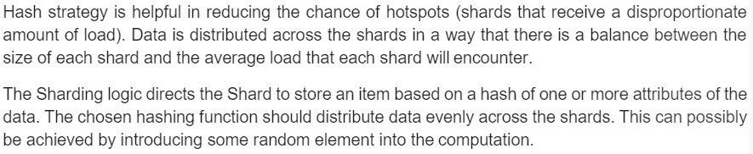

Slide 29
Algorithmic sharding or hashed sharding, takes a record as an input and applies a hash function or algorithm to it which generates an output or hash value. This output is then used to allocate each record to the appropriate shard.
The function can take any subset of values on the record as inputs. Perhaps the simplest example of a hash function is to use the modulus operator with the number of shards, as follows:
Hash Value=ID % Number of Shards
This is similar to range-based sharding — a set of fields determines the allocation of the record to a given shard. Hashing the inputs allows more even distribution across shards even when there is not a suitable shard key, and no lookup table needs to be maintained. However, there are a few drawbacks.
First, query operations for multiple records are more likely to get distributed across multiple shards. Whereas ranged sharding reflects the natural structure of the data across shards, hashed sharding typically disregards the meaning of the data. This is reflected in increased broadcast operation occurrence.
Second, resharding can be expensive. Any update to the number of shards likely requires rebalancing all shards to moving around records. It will be difficult to do this while avoiding a system outage.

Slide 30
Hashed Sharding
Even Data Distribution: Because input keys are hashed, data is evenly spread, preventing any single shard from becoming a performance bottleneck.
Preventing Hotspots: It is highly effective for write-heavy applications where sequential data (like timestamps) would otherwise overwhelm a single server.
Fixed Shard Count Constraint: A major disadvantage is that adding or removing servers often requires significant data redistribution (re-sharding) because the hash(key) % n formula changes.
Reduced Range Queries: Since related data is scattered across shards, range queries (e.g., "get all users registered today") are inefficient, unlike in range-based sharding.
Use Cases: Best for systems needing high write throughput (e.g., IoT, logging) where data is accessed by a specific ID (e.g., user_id).
Hash Sharding Process:
Select Shard Key: Choose a high-cardinality field (e.g., user_id or uuid).
Apply Hash Function: The system computes hash(key).
Determine Shard ID: The hash result is mapped to a specific shard, often using modulo (e.g., hash(key) % n).

Slide 31
Advantages of Sharding
Reads / Writes: MongoDB distributes the read and write workload across the shards in the sharded cluster, allowing each shard to process a subset of cluster operations.
Both read and write workloads can be scaled horizontally across the cluster by adding more shards.
Storage Capacity: Sharding distributes data across the shards in the cluster, allowing each shard to contain a subset of the total cluster data.
As the data set grows, additional shards increase the storage capacity of the cluster.
High Availability: If one or more shard replica sets become completely unavailable, the sharded cluster can continue to perform partial reads and writes.
That is, while data on the unavailable shard(s) cannot be accessed, reads or writes directed at the available shards can still succeed.

Slide 32
Disadvantages of sharding
Query overhead: Each sharded database must have a separate machine or service which understands how to route a querying operation to the appropriate shard. This introduces additional latency on every operation.
Furthermore, if the data required for the query is horizontally partitioned across multiple shards, the router must then query each shard and merge the result together. This can make an otherwise simple operation quite expensive and slow down response times.
Complexity of administration: With a single unsharded database, only the database server itself requires upkeep and maintenance. With every sharded database, on top of managing the shards themselves, there are additional service nodes to maintain.
Increased infrastructure costs: Sharding by its nature requires additional machines and compute power over a single database server.
While this allows your database to grow beyond the limits of a single machine, each additional shard comes with higher costs.
The cost of a distributed database system, especially if it is missing the proper optimization, can be significant.

Slide 33
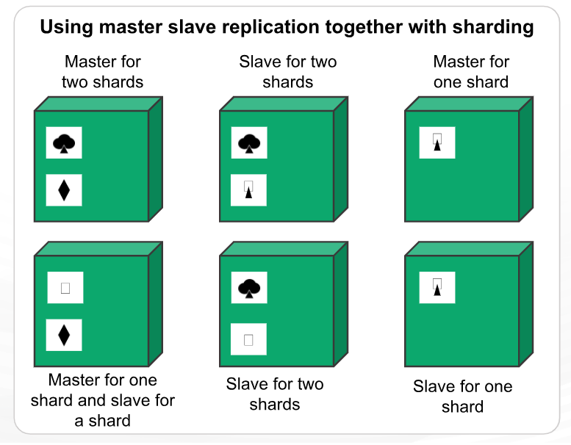
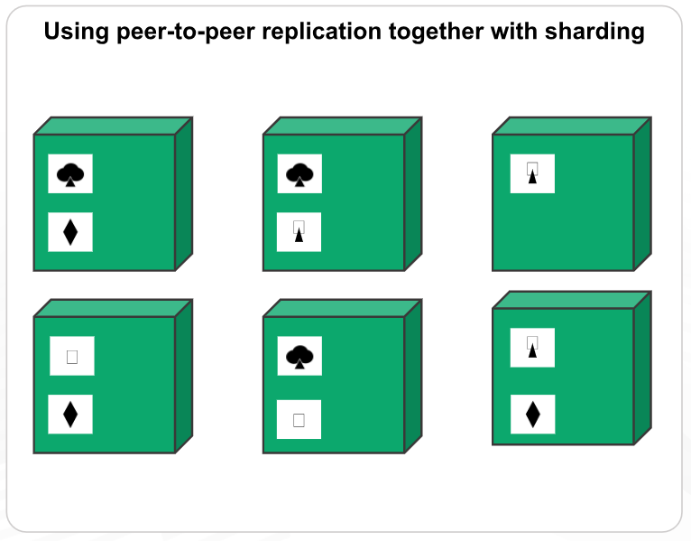
Combining Replication and Sharding (Sharded Replica Set)
With a combination of Master-slave replication and sharding, we can have multiple masters, but each data item can have only one master. Based on the configuration, we can choose a node to be the master for some data and slaves for others.
Using peer-to-peer replication and sharding, there will be tens or hundreds of nodes in a cluster with data shared over them.

Slide 34
Master-slave Replication with Sharding
Master (Primary) for a Shard: The node within a specific shard responsible for all write operations (and usually reads) for its subset of data.
Slave (Secondary) for a Shard: One or more nodes that sync with the master to maintain a copy of the shard's data, used for read scaling and failover.
Architecture Example
Whole Database = Shard 1 + Shard 2 + Shard 3
Shard 1 = {Master A, Slave A1, Slave A2}
Shard 2 = {Master B, Slave B1, Slave B2}
Shard 3 = {Master C, Slave C1, Slave C2}
If "Master A" goes down, "Slave A1" or "A2" is elected as the new primary for Shard 1, allowing the application to continue functioning
Advantages
Horizontal Scaling: Increases write throughput by adding more shards.
Read Throughput: Increased by adding more slave nodes per shard.
Fault Tolerance: Data is not lost if a server fails, as replicas (slaves) exist.

Slide 35
Peer-to-Peer Replication with Sharding
The database is divided into shards (sharding). Each shard is not just one node, but a set of replicas working in a P2P fashion (multi-master).
Data Distribution: Data is partitioned across different sets of servers, so each server acts as a node for a subset of the total data.
Consistency: P2P offers high availability but may result in "eventual consistency." If two nodes receive conflicting writes, complex conflict resolution is required.

